Slide 1

Suicide Attempt Prediction Using Classification

Slide 2

Dataset
time [date]
gender [string]
sexuallity [string]
age [numeric]
income [string]
race [string]
bodyweight [string]
virgin [string]
prostitution_legal [string]
pay_for_sex [string]
friends [numeric]
social_fear [string]
depressed [string]
what_help_from_others [string] attempt_suicide [string]
employment [string]
job_title [string] edu_level [string] improve_yourself_how [string]

Slide 3

Normalization and Feature Selection
gender [numeric]
age [numeric]
virgin [numeric]
prostitution_legal [numeric]
pay_for_sex [numeric]
friends [numeric]
social_fear [numeric]
depressed [numeric]

Slide 4

Decision Tree Classification
friends, depressed, social_fear, virgin, income,
bodyweight
Test data: 10.0 %
Accuracy: 0.82
precision recall f1-score
0 0.87 0.92 0.89
1 0.40 0.29 0.33
Confusion Matrix
[34 3]
[ 5 2]

Slide 5

Random Forest Classification
friends, depressed, social_fear, virgin, income,
bodyweight
Test data: 10.0 %
Accuracy: 0.82
precision recall f1-score
0 0.85 0.95 0.90
1 0.33 0.14 0.20
Confusion Matrix
[35 2]
[ 6 1]

Slide 6
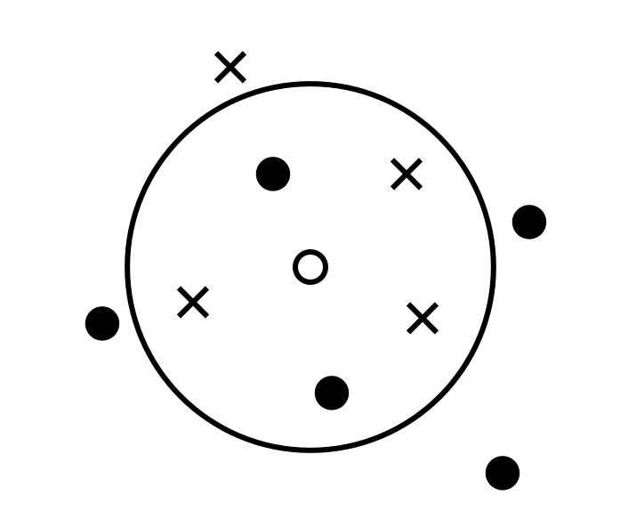

K-Nearest Neighbors Classification
age, friends, depressed, social_fear, virgin,
gender, pay_for_sex, income, bodyweight
Test data: 10.0 %
Accuracy: 0.80
precision recall f1-score
0 0.83 0.95 0.89
1 0.00 0.00 0.00
Confusion Matrix
[35 2]
[ 7 0]

Slide 7
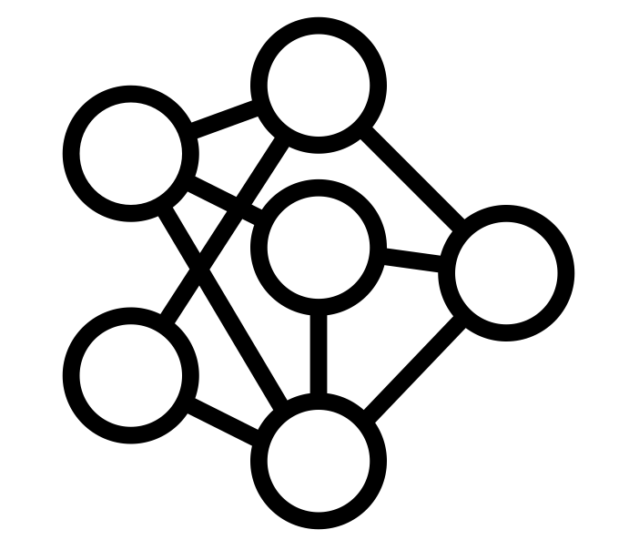

MLP Neural Network
age, friends, depressed, social_fear, virgin,
gender, pay_for_sex, income, bodyweight
Test data: 10.0 %
Accuracy: 0.86
precision recall f1-score
0 0.86 1.00 0.92
1 1.00 0.14 0.25
Confusion Matrix
[37 0]
[ 6 1]

Slide 8
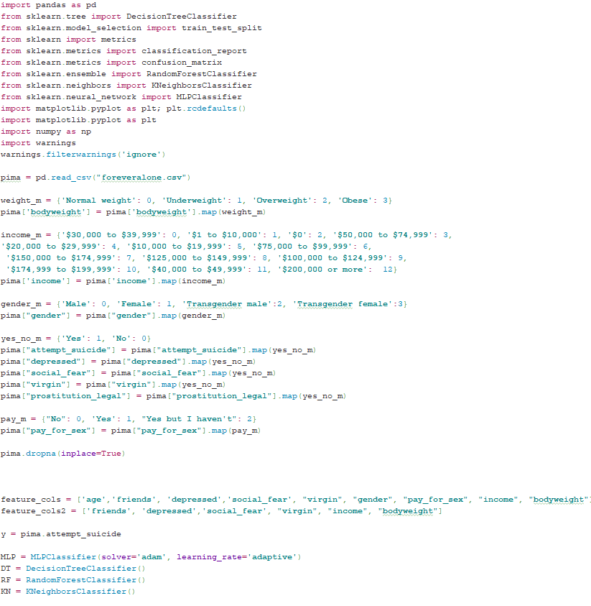


Slide 9
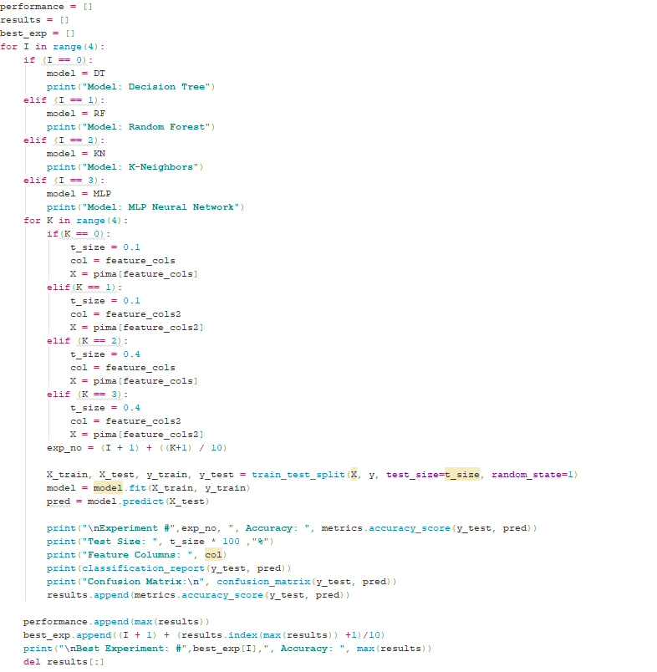


Slide 10

Thanks!
Arif A. Balik github.com/arifbalik/DMProject

